Slide 1
TV series in the language classroom
Anna Iacovella
Yale University
Anna.iacovella@yale.edu

Slide 2
WORLD-READINESS STANDARDS FOR LEARNING LANGUAGES & the 5C’s
 | Relating Cultural Practices to Perspectives: Learners use the language to investigate, explain, and reflect on the relationship between the practices and perspectives of the cultures studied. | Relating Cultural Products to Perspectives: Learners use the language to investigate, explain, and reflect on the relationship between the products and perspectives of the cultures studied.
The ACTFL standard relates cultural practices to perspectives and relating cultural products to perspective.

Slide 3
Mediatic content including films and TV series can motivate students to learn a language.

Slide 4
Video streaming services provide a wide array of TV shows, movies and exclusive content : Classic & Contemporary
Netflix has around 11,000 total titles.
Amazon Prime Video has 180,000+ movies and more than 4,500 TV shows.

Slide 5
Squid Game Korean TV series released worldwide on September 17, 2021 on Netflix. Is top-viewed program in 94 countries and attracting more than 142-million-member households.

Slide 7
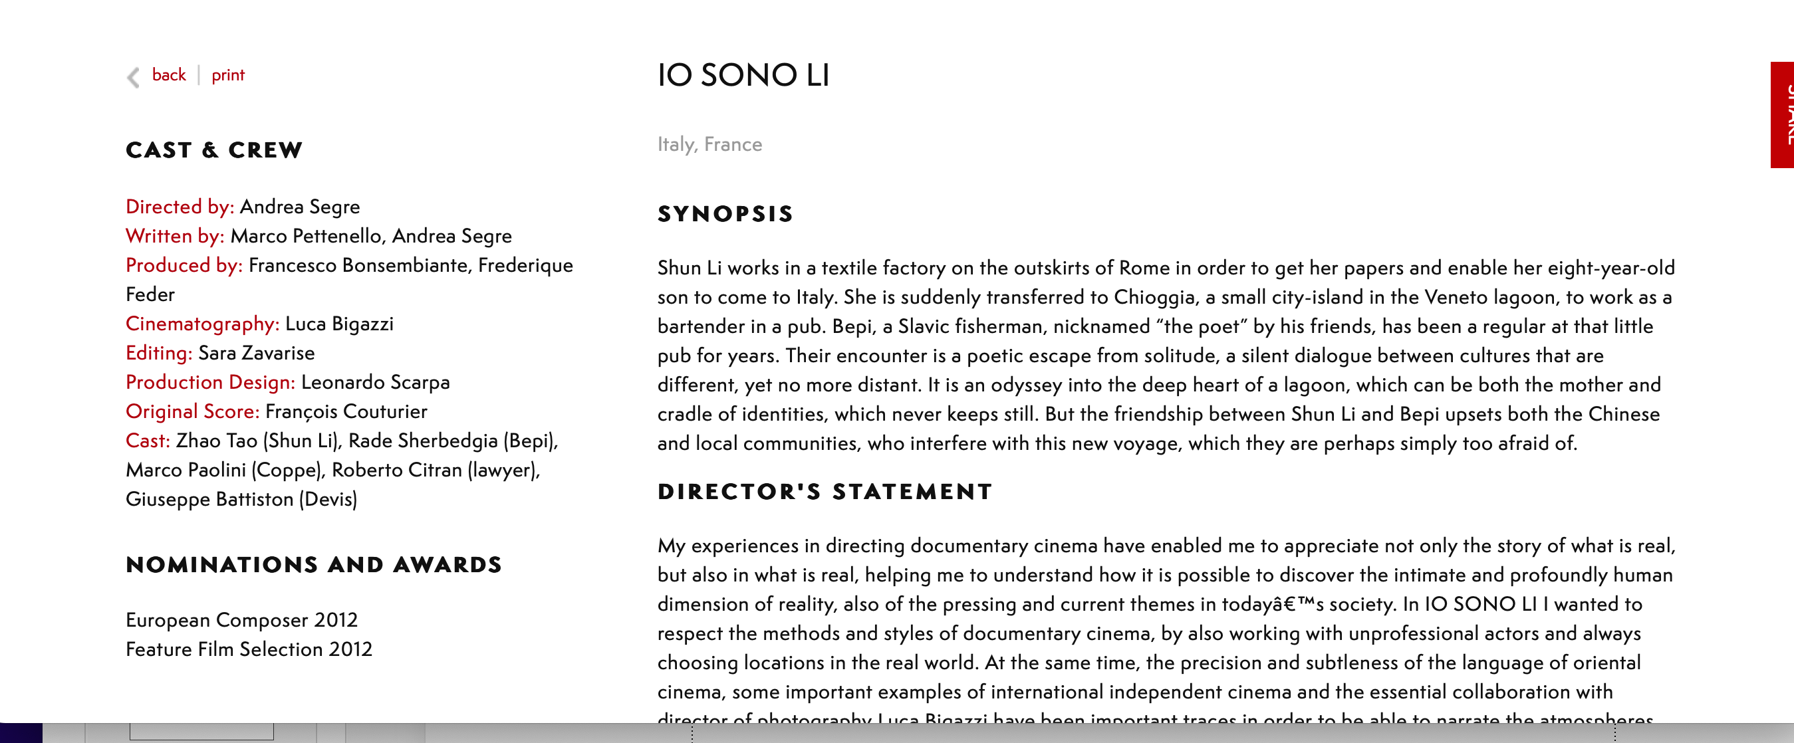
“Io sono Li” – Andrea Segre (2011) Completa il testo con le seguenti parole: amata, pescatori, vedovo, malavitosa, si ricongiunge, dichiarata, si inserisce, latente, ostacolata, motivo, energumeno, tessile, immigrata. Shun Li, un’__________ cinese, lavora in un laboratorio ________ vicino a Roma. Per emigrare in Italia ha contratto un debito con un’organizzazione __________ cinese. Li sogna di poter ritrovare la propria libertà restituendo i soldi e facendo venire poi in Italia il figlio di otto anni. Senza alcun _________ apparente i suoi “padroni” la mandano a Chioggia a fare la barista in una povera osteria frequentata da _____________ e anziani pensionati. Malgrado le iniziali difficoltà linguistiche e culturali, Li ________ bene nell’ambiente e inizia un delicato rapporto sentimentale con Bepi, un pescatore solitario di origini slave. Bepi è chiamato “il poeta,” è ___________ di un’italiana ed ha un figlio che vive sulla terraferma. L’amicizia fra Li e Bepi è prima criticata e poi decisamente _____________ sia dalla chiusa comunità cinese sia dagli abitanti di Chioggia, che nascondono dietro la ____________ preoccupazione per un matrimonio d’interesse il loro ___________ razzismo. Nelle violente discussioni che seguono un ___________ picchia Bepi, facendolo allontanare tristemente dal gruppo di “amici.” Li ritorna ad essere libera, si trasferisce altrove, apre un laboratorio in proprio, e finalmente ________ al figlio. Quando ritornerà a Chioggia per un breve viaggio della memoria verrà a sapere che Bepi è morto a Mestre, dopo aver abbandonato la sua __________ laguna.

Slide 8
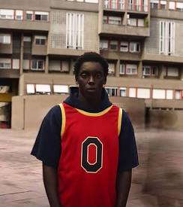
As films also TV series deal with compelling and important social issues
The same activities for a traditional film such as Io sono Li, can also be adapted for a TV series as Zero on Netflix
Activities are adapted to the level of knowledge

Slide 9
My Brilliant Friend from text to TV series (HBO & Prime Video) for Synchronous & Asynchronous activities
Conversazione:
Perché secondo te c'è tutta questa violenza nel rione? Come la descrive Elena?
Che cosa succede a Melina?
- Leggete la parte 6 dell'Infanzia, pag. 37-39 de L'amica geniale e scrivete cinque nuove parole nel glossario.

Slide 10
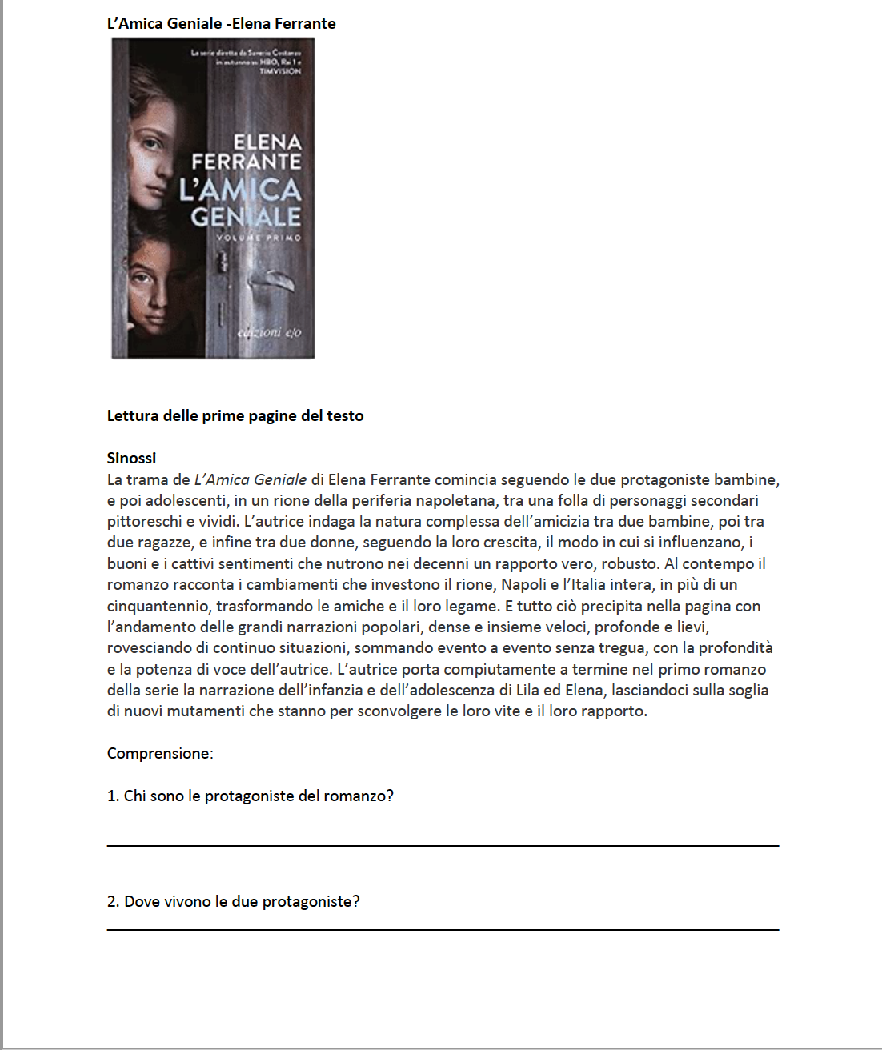
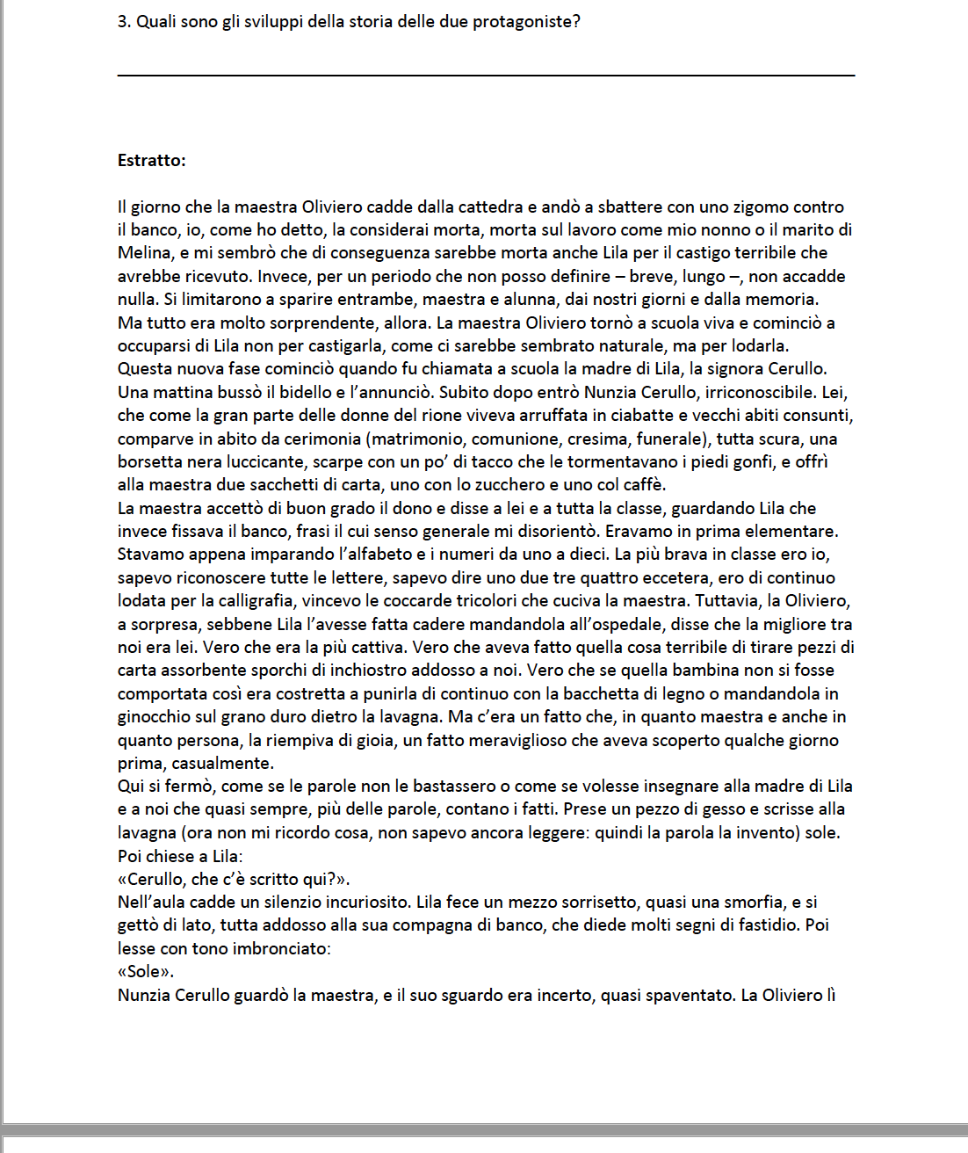
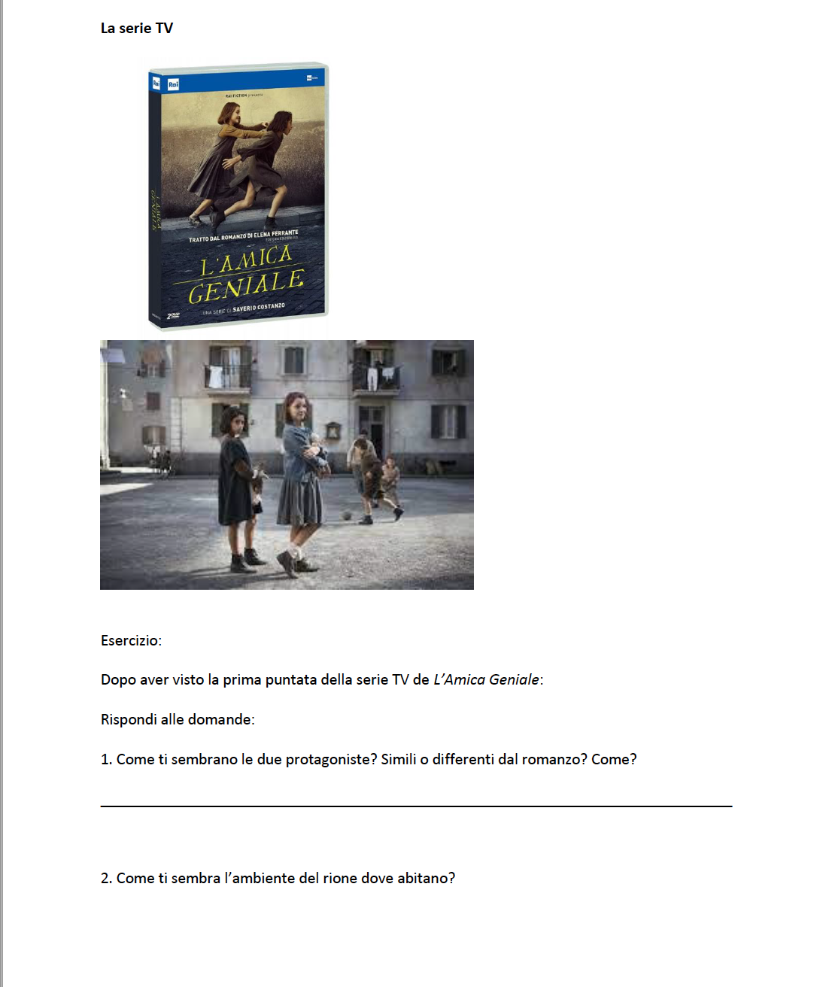
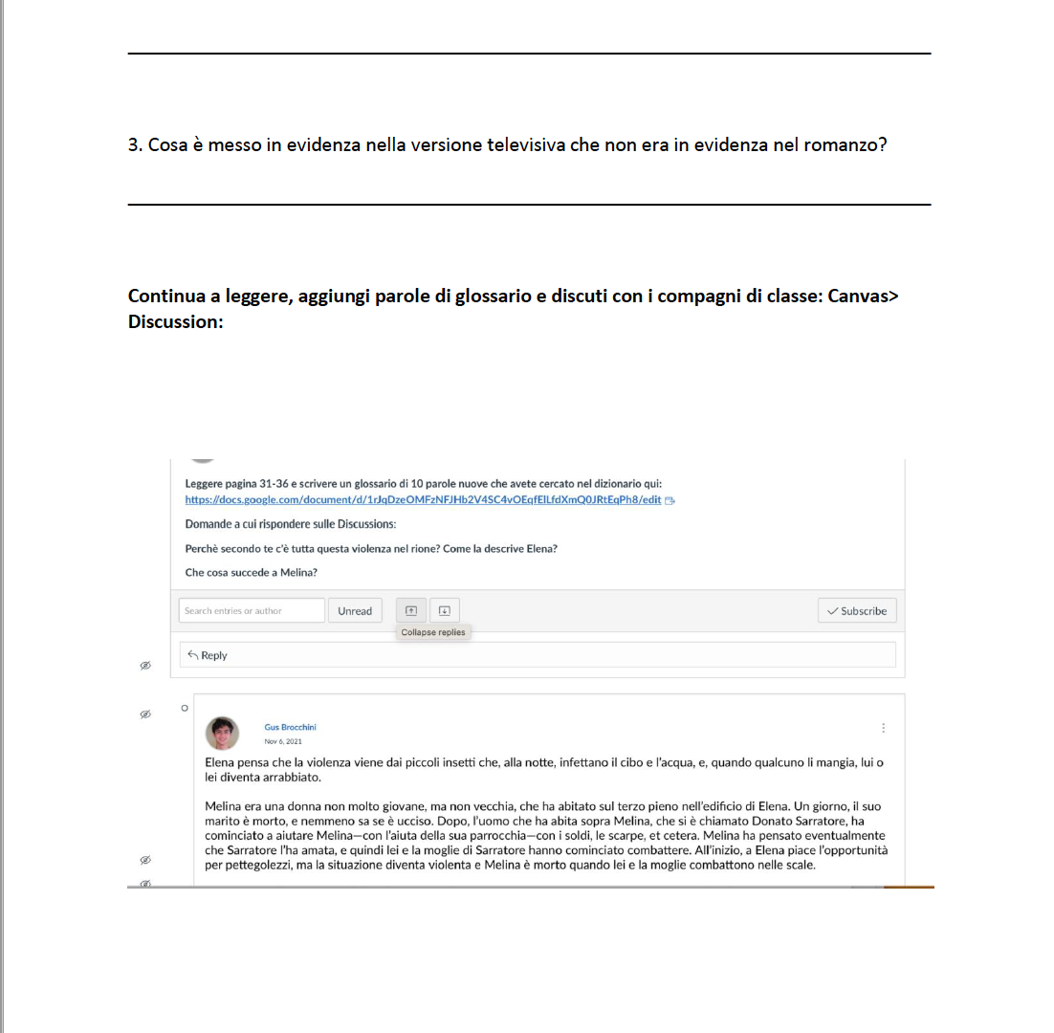
activities
Reading text and comprehension exercises and discussions
Viewing and discussions with vocabulary expansion

Slide 11
Summertime
Students enjoy the series for various reasons: because of the seaside town and the beach; they can relate to the characters as teenagers coming of age.
Students notice the colloquial expressions and the extended use of English (Italianized at times).
But they also appreciate the soundtrack which is a mixture of music by young Italian artists complemented by the 1960’s 70s and 80s music.
Which can be found on Spotify. https://open.spotify.com/playlist/2UecGmmLIXauRufzbCr9X9

Slide 12
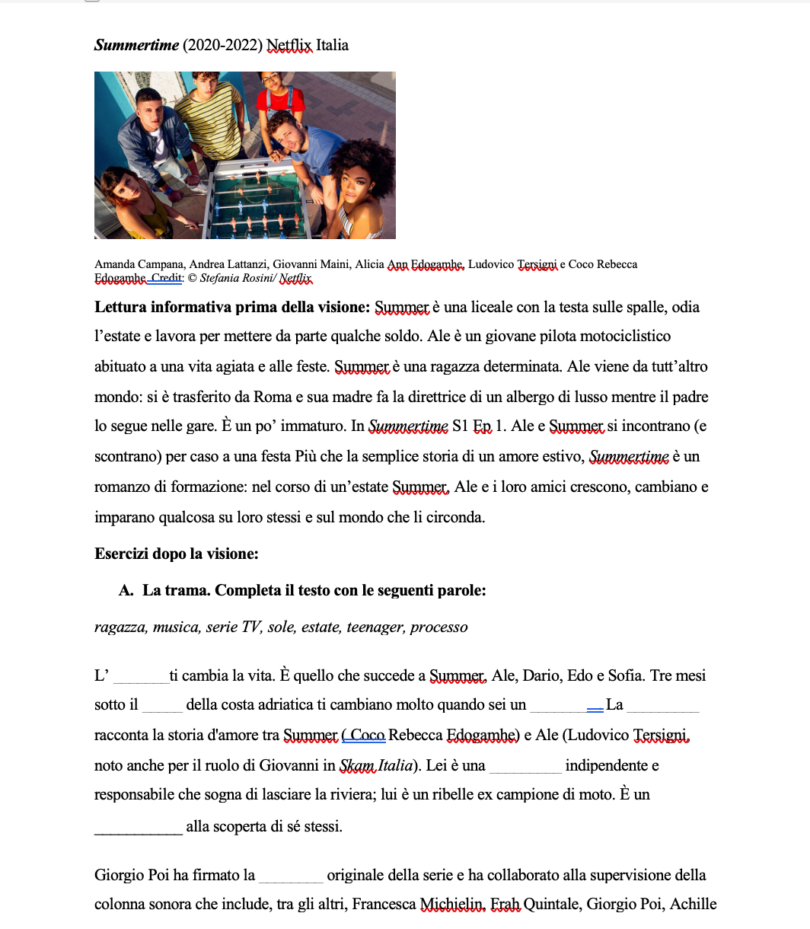
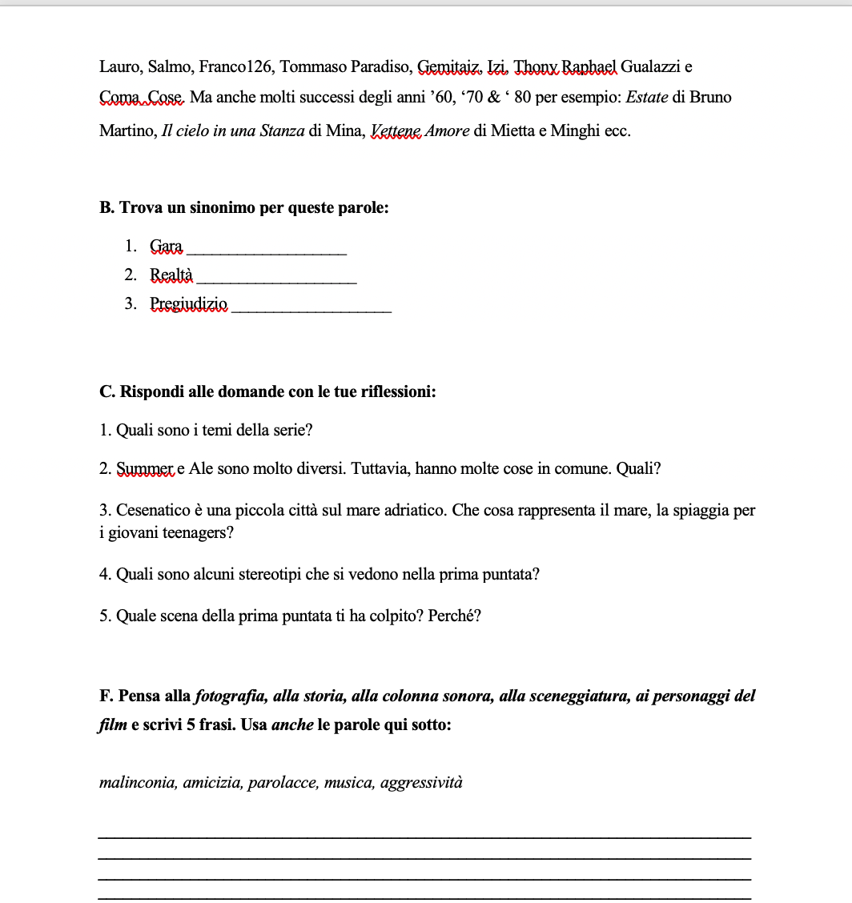
Actvities
A. Reading and comprehension
B. Synonyms
C. Answer questions and reflection & writing with the use of film techniques with vocabulary

Slide 13
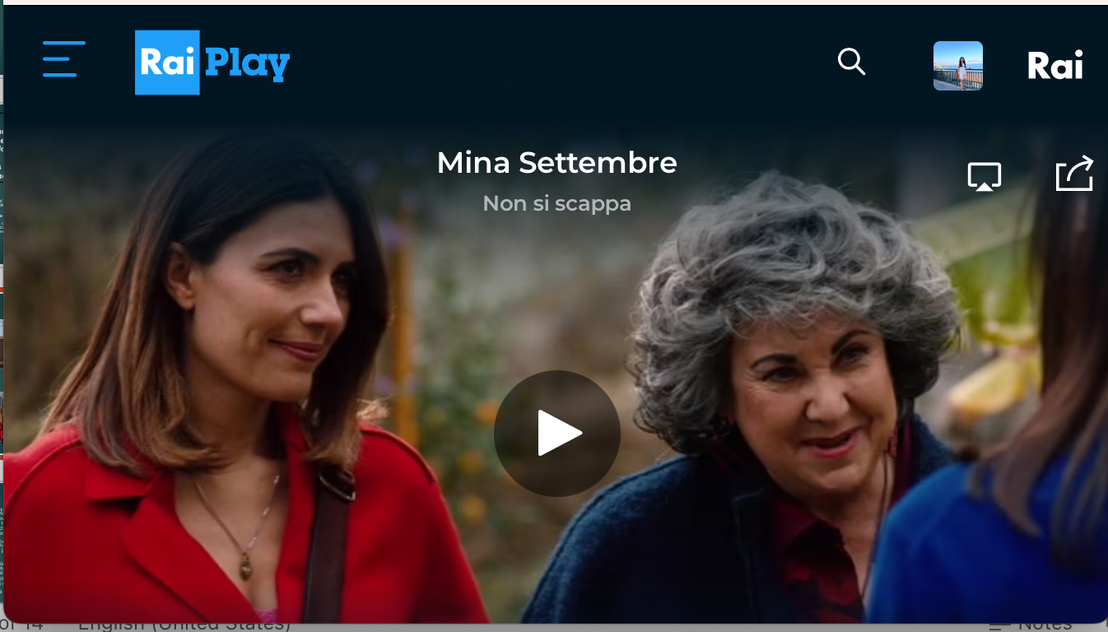
Mina Settembre
RaiPlay
Season 1 & 2
Gelsomina Settembre, or Mina, è is a social worker in a family center in Naples, Italy. She is always looking for alternative ways to help. Those who come to the center and her friends; however, she is also trying to find her stability in her personal life. The fiction is based on Maurizio DeGiovanni’s novel series.
DeGiovanni contributed to write the scripts for Mina Settembre as for his previous detective novel series such as Il Commissario Ricciardi and The Bastards of Pizzofalcone also TV series on RaiPlay.
the TV series as the novels, offer great opportunities to have students notice and discuss cultural hints and idiomatic expressions.

Slide 14
Suggested shows and series (Not only in Italian)
Guida astrologica per cuori infranti/An astrological guide for broken hearts (Netflix):
Is Based on the novel by Silvia Zucca, it is the story of Alice who finds herself having to question both her personal and professional life. Luckily for her, Tio stumbles into her life and offers her the solution to all her worldly torments: Astrology. Not the one pedaled in newspapers, but a “real” reading of the stars, which exists to guide us through the emotional ups and downs of life. Strangely though, astral affinity does not prevent her from experiencing a series of bad dates, embarrassing misunderstandings and awkward surprises.
Medici: The Magnificent shows the power of art and beauty as driving forces behind Medici rule. The series shows the journey of a man who falls many times before he can find himself again.
Cattelan: Una semplice domanda (or One simple question) is on Netflix or Roku:
The discovery of happiness is a journey that Alessandro Cattelan (TV host and producer) takes us on: from Roberto Baggio’s car to Paolo Sorrentino’s directing, passing through golf-courses with Gianluca Vialli and camping with Geppi Cucciari. A closed supermarket is waiting for Ale and Francesco Mandelli, while Elio will be Ale’s personal coach for the new edition of X Factor Hungary.

Slide 15
Thank you! Grazie!
Questions?

